Slide 1

An Authenticated Mental Health Care Digital Antidepressant Forum for Truncating Anxiety and Depression using Cloud Firestore Database and Figma
Presented in:
IIRA-2022
Held at:
Moradabad Institute of Technology
Presented by:
Ibad Ur Razzaq
Authors:
Richa Saxena
Mohd Zaid Amaan
Ibad Ur Razzaq
Mohammad Amaan

Slide 2
overview
INTRODUCTION
PROBLEM STATEMENT
EXISTING TECHNOLOGIES
METHODOLOGY
TECHNOLOGY USED
DATABASE HANDLING
CONCLUSION

Slide 3
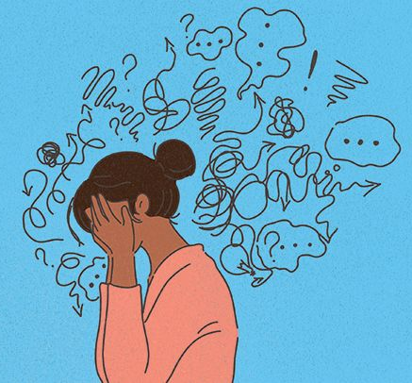
INTRODUCTION
Mental health problems range from the worries we all experience as part of everyday life to serious long-term conditions. The majority of people who experience mental health problems can get over them or learn to live with them, especially if they get help early on.
Mental health problems are becoming frequent nowadays which cause people depression and anxiety.
Mental Health is commonly affecting the youth which causing them deviation in the path of their aims and goals.

Slide 4
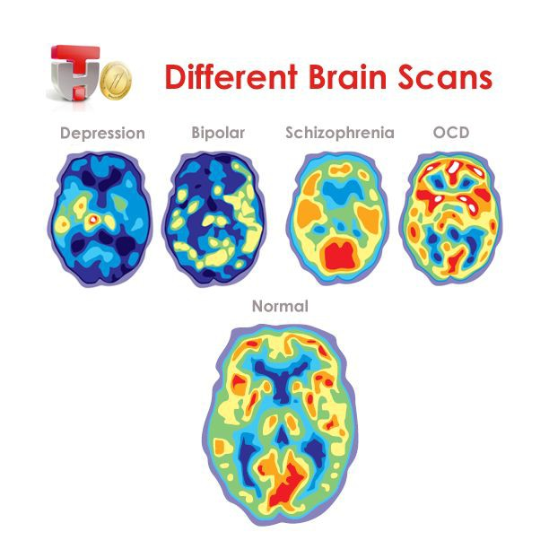
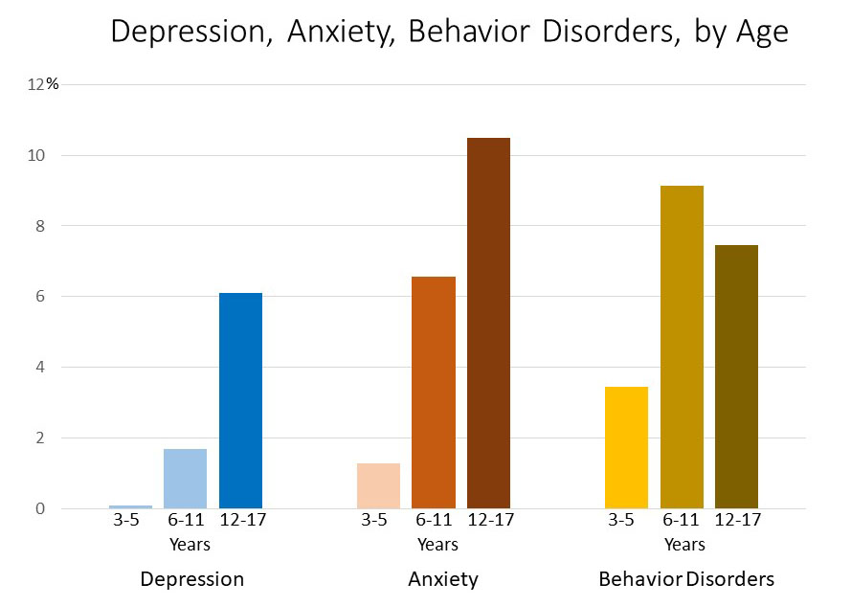
PROBLEM STATEMENT
Mental health has growing priority across the Region, owing to the awareness of both the human and economic costs to society and the suffering of individuals
Mental disorders among children are described as serious changes in the way children typically learn, behave, or handle their emotions as they are the youth of nation it effects the future world.
Some major Signs And Symptoms:
Feeling sad or down
Confused thinking
Suicidal thinking
Problems with alcohol or drug use
Extreme mood changes
Detachment from reality (delusions)

Slide 5
EXISTING TECHNOLOGIES
Previous researchers have discovered that mental health apps are somewhere effective in reducing anxieties and depression with a universal effect length of low to mild.
Weak areas of some of the existing MHapps:
It clearly shows that a large number of users have usability issues because many users have complained about UI design which includes layout/clarity problems, and bad navigation.
Unaffordability is also a major concern

Slide 6
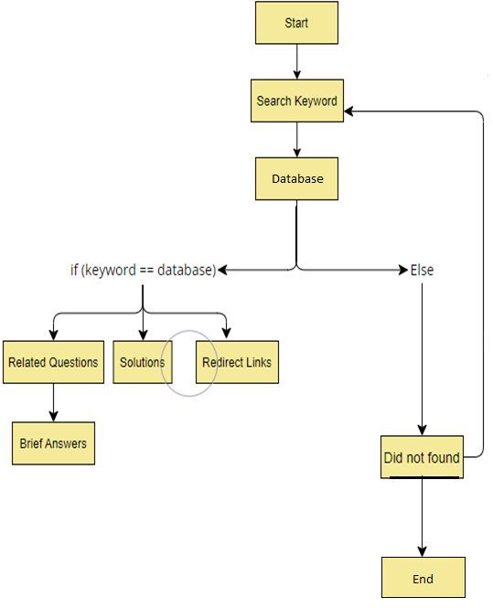
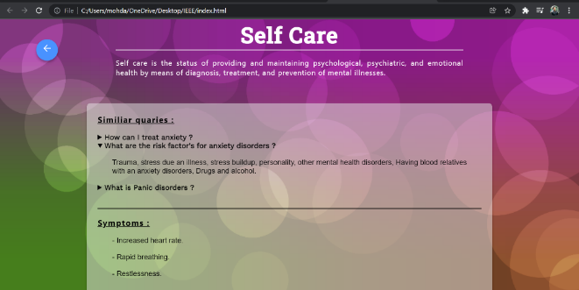
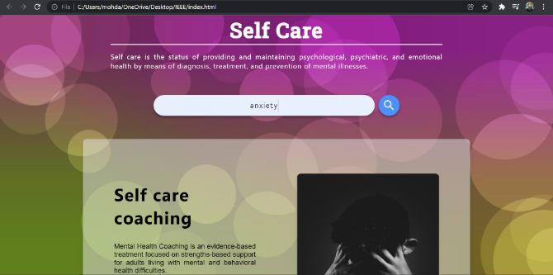
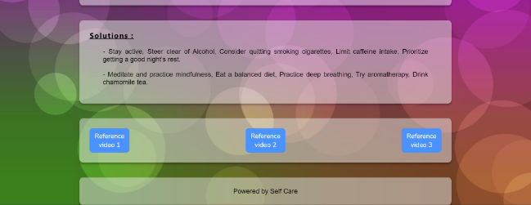
METHODOLOGY
When a user searches a keyword regarding its mental health issue then the keyword will compare to our Firestore Cloud database, after finding it in database, it will extract the relevant solutions and displays on the site. It will also show the relevant Questions regarding that searched keyword. The site will also enlist the symptoms regarding that mental health problem and YouTube links of Meditation at the bottom of the page.

Slide 7

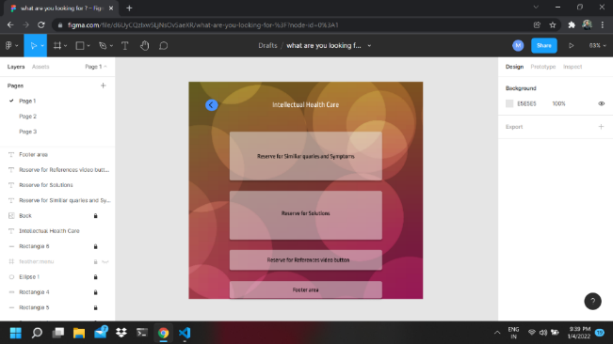
TECHNOLOGIES USED
FIGMA
Figma is a layout tool
It is frequently taken into consideration to
be an alternative to sketch.
The prototype of our site has been designed
by the Figma.

Slide 8
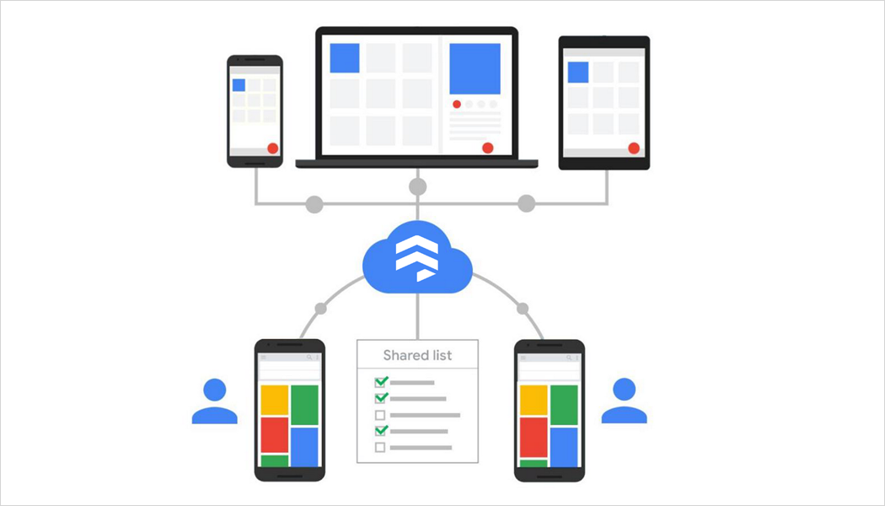

FIRESTORE CLOUD DATABASE
Firebase is a development platform that helps
you build, improve, and grow your app.
Firebase is a Backend-as-a-service.
Firebase uses NOSQL JSON based data for its Realtime database

Slide 9
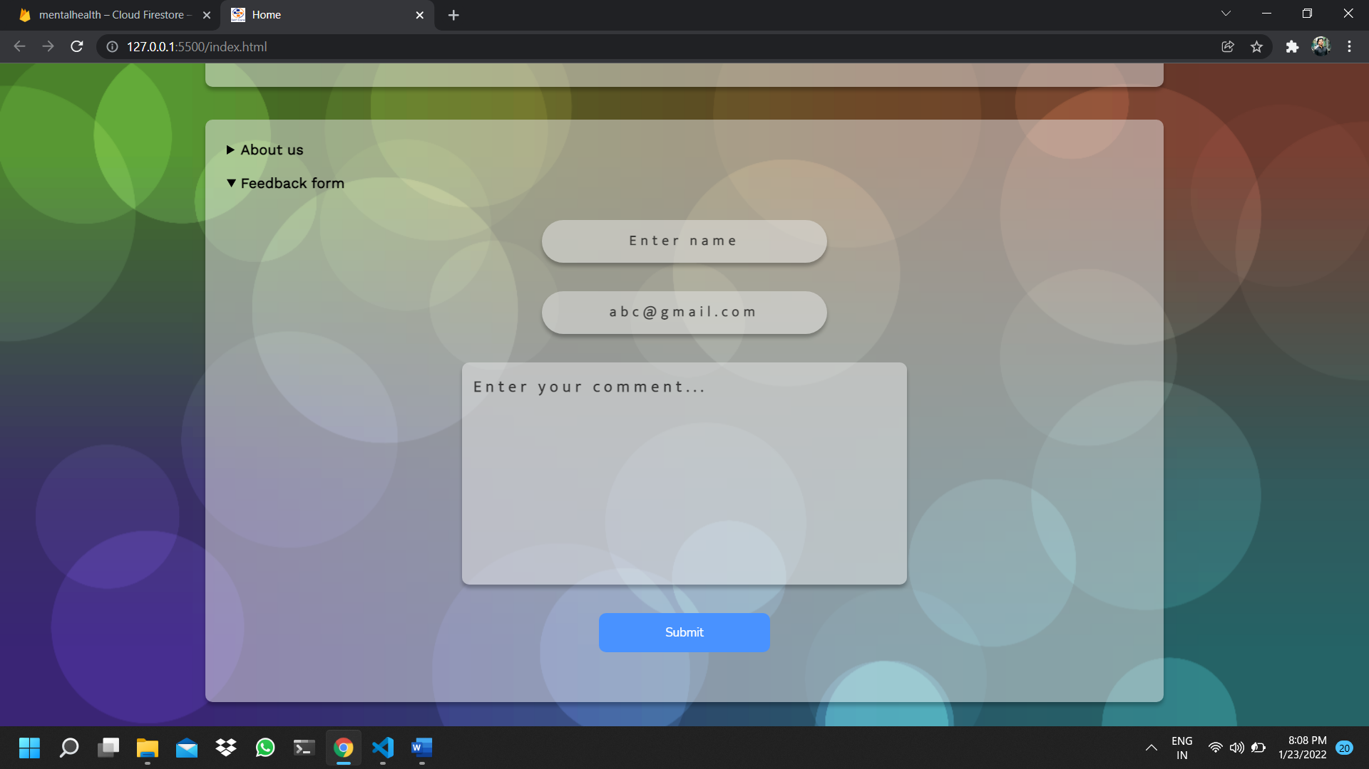
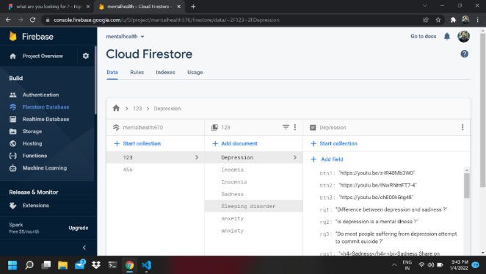
DATABASE HANDLING
User searches a keyword regarding its mental health issue
Keyword will match to our Firestore Cloud database,
It will extract the relevant Data regarding that issue
We have created two collections here in Firestore Database:
First one is “123” which contains keywords and their corresponding data
Second one is “456” which is storing the feedbacks along with the customers data.

Slide 10
CONCLUSION
Symptoms | %
Depression | 21.7
Anxiety | 18.8
General Mental Health | 25.4
Stress | 10.0
Post-traumatic stress disorder | 2.6
Bipolar disorder | 3.7
Panic disorder | 3.6
Sleep disorder | 7.5
Schizophrenia | 1.9
Obsessive compulsive disorder | 4.5
Substance abuse (Drug and Alcohol) | 0.3
Addiction (Non drug and alcohol related addiction) | 2.2
No specific symptom or diagnosis mentioned | 1.7
Total | 100.0
Approaches to improving mental health | %
Relaxation | 32.4
Stress management | 12.5
Symptom tracking | 23.6
Calming audio | 10.7
Connect with mental health resources | 2.1
Interpersonal support | 3.7
Meditation | 16.6
Total | 100
One need to understand that mental health is as much as important as physical health that’s why this site has been created to create awareness and in lowering the mental health depression.
It predominantly focuses upon the information that is needed for a person to acquire proper solution.

Slide 11
Thank You!

Slide 12
Any Queries?

